Slide 1


Daniel Eduardo López
July 26, 2022

Slide 2

Outline
Executive Summary
Introduction
Methodology
Results
Conclusion
Appendix

Slide 3
Executive Summary
Summary of methodologies
Summary of all results

Slide 4
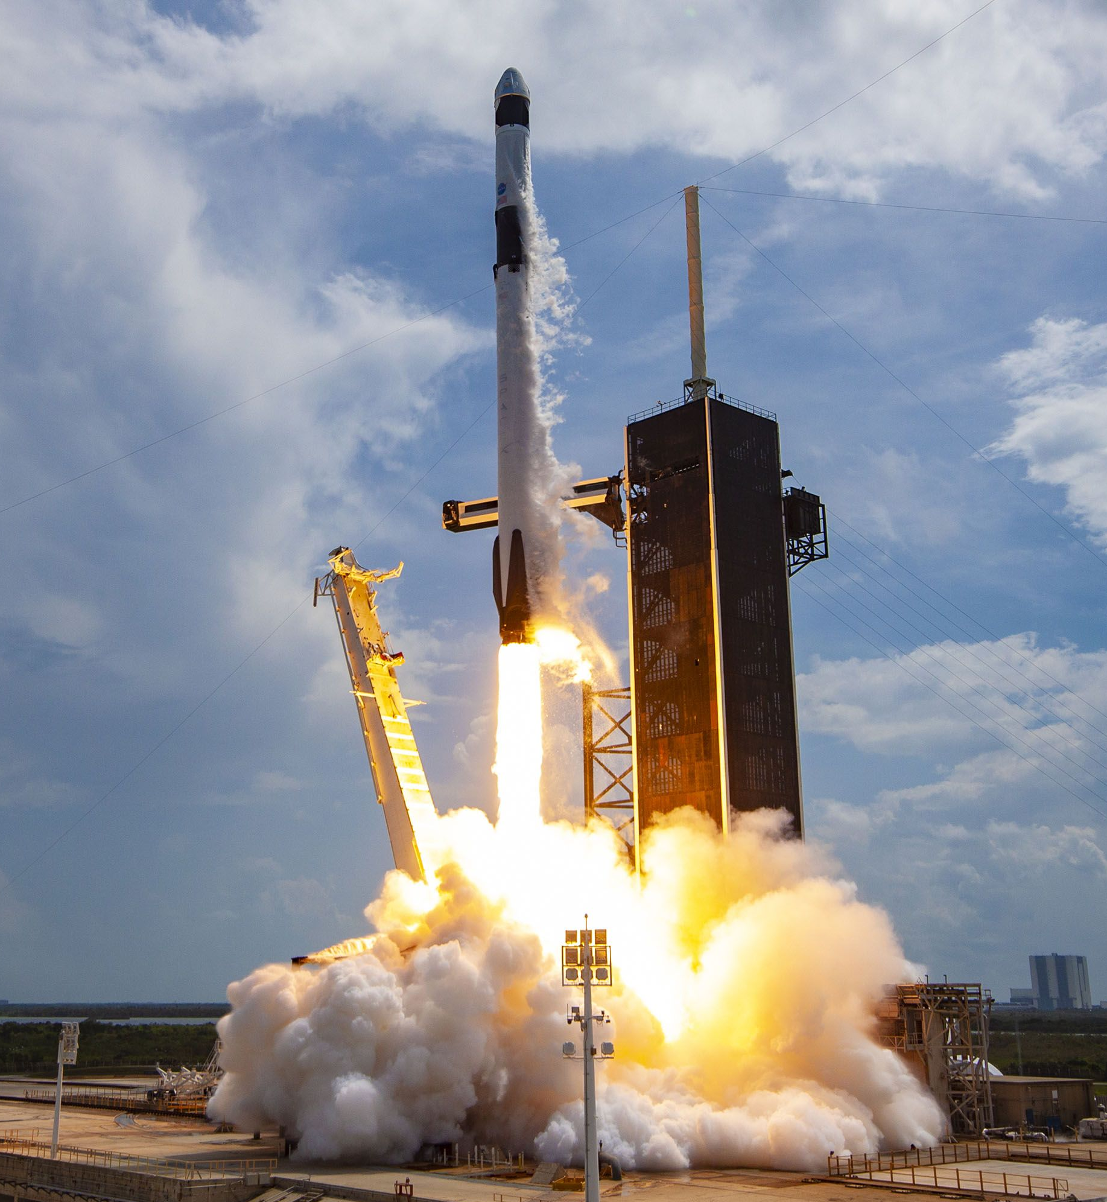
Introduction
SpaceX offers Falcon 9 rocket launches with a cost of 62 million dollars while other providers cost upward of 165 million dollars each. A significant amount of the savings is due to SpaceX's ability to reuse the first stage.
In this context, the main goal of the present study is to predict the first stage landing of the SpaceX Falcon 9 rocket launch by using a classification model in order to determine the cost of a launch.
Furthermore, it is also desirable to obtain other insights from the SpaceX Falcon 9 rocket launches.

Slide 5

Section 1

Slide 6
Methodology
Executive Summary
Data collection methodology:
Describe how data was collected
Perform data wrangling
Describe how data was processed
Perform exploratory data analysis (EDA) using visualization and SQL
Perform interactive visual analytics using Folium and Plotly Dash
Perform predictive analysis using classification models
How to build, tune, evaluate classification models

Slide 7
Data Collection
Data sets were collected through SpaceX API and Web Scrapping in Python 3 by using the libraries requests, pandas, numpy, BeautifulSoup, among others.
SpaceX API
Web Scrapping
Data sets

Slide 8
Data Collection – SpaceX API
Set URL and GET Request
Response Decoding
Data Combination and Conversion to Dataframe
Functions Definition and API calls
Filtering (Falcon 9 only)
Missing Values Imputing (mean)
Link of the data source:
https://cf-courses-data.s3.us.cloud-object-storage.appdomain.cloud/IBM-DS0321EN-SkillsNetwork/datasets/API_call_spacex_api.json
GitHub URL:
https://github.com/DanielEduardoLopez/IBM-SpaceX/blob/main/1-Spacex-data-collection-api.ipynb

Slide 9
Data Collection - Scraping
Link of the data source:
https://en.wikipedia.org/wiki/List_of_Falcon\_9\_and_Falcon_Heavy_launches
GitHub URL:
https://github.com/DanielEduardoLopez/IBM-SpaceX/blob/main/2-Webscraping.ipynb
Set URL and GET Request
BeautifulSoup Object Creation
HTML Tables Parsing
Conversion to Pandas Dataframe

Slide 10
Data Wrangling
Column Types Identification
Missing Values Identification
Number of Launches per Site
Number and occurrence of each orbit
Number and occurence of mission outcome per orbit type
Landing Outcome Label Creation
The purpose of this step was to find some patterns in the data and determine what would be the label for training supervised models.
GitHub URL:
https://github.com/DanielEduardoLopez/IBM-SpaceX/blob/main/3-Spacex_Data_wrangling.ipynb

Slide 11
EDA with Data Visualization
The purpose of this step was to perform Exploratory Data Analysis with Pandas and Matplotlib. The following charts were plotted:
Scatter Plot of "Flight Number" vs. "Payload Mass": To assess the likelihood of the first stage return in function of the Payload Mass and the Flight Number.
Scatter Plot of "Flight Number" vs. "Launch Site": To assess the relationship among Launch Site, Flight Number, and the Class.
Scatter Plot of "Payload Mass" vs. "Launch Site": To assess the relationship among Launch Site, Payload Mass and the Class.
Bar chart of the "Orbit" "Success Rate": To assess the sucess rate of each orbit.
Scatter Plot of "Flight Number" vs. "Orbit": To assess the relationship among Flight Number, Orbit, and the Class.
Scatter Plot of "Payload Mass" vs. "Orbit": To assess the relationship among Payload Mass, Orbit, and the Class.
Line Chart of "Payload Mass" vs. "Orbit": To visualize the launch success yearly trend.

Slide 12
Feature Engineering
In addition, Feature Engineering was carried out to select the features that were used in the classification model:
'FlightNumber', 'PayloadMass', 'Orbit', 'LaunchSite', 'Flights', 'GridFins', 'Reused', 'Legs', 'LandingPad', 'Block', 'ReusedCount', 'Serial'
Then, dummy variables were created for the categorical variables Orbits, LaunchSite, LandingPad, and Serial using the get_dummies() function.
Finally, the whole dataset was casted to float64 datatype.
GitHub URL:
https://github.com/DanielEduardoLopez/IBM-SpaceX/blob/main/5-EDA_dataviz.ipynb

Slide 13
EDA with SQL
Furthermore, the following SQL queries were performed after loading the dataset into a corresponding table in a database using the libraries sqlite3 and sqlalchemy:
SELECT Launch_Site, COUNT(Launch_Site) AS Count FROM SPACEXTBL GROUP BY Launch_Site;
SELECT * FROM SPACEXTBL WHERE Launch_Site LIKE 'CCA%' LIMIT 5;
SELECT SUM(PAYLOAD_MASS__KG_) FROM SPACEXTBL WHERE Customer = 'NASA (CRS)';
SELECT AVG(PAYLOAD_MASS__KG_) FROM SPACEXTBL WHERE Booster_Version LIKE 'F9 v1.1%';
SELECT MIN(Date) FROM SPACEXTBL WHERE "Landing _Outcome" = 'Success (ground pad)';

Slide 14
EDA with SQL
SELECT Booster_Version FROM SPACEXTBL WHERE "Landing _Outcome" = 'Success (drone ship)' AND PAYLOAD_MASS__KG_ > 4000 AND PAYLOAD_MASS__KG_ < 6000;
SELECT Mission_Outcome, COUNT(Payload) FROM SPACEXTBL GROUP BY Mission_Outcome;
SELECT Booster_Version FROM SPACEXTBL WHERE PAYLOAD_MASS__KG_ = (SELECT MAX(PAYLOAD_MASS__KG_) FROM SPACEXTBL);
SELECT SUBSTR(Date,1,4) AS Year, COUNT("Landing _Outcome") AS Successful_landing_outcomes FROM SPACEXTBL WHERE DATE > '2010-06-04' AND DATE < '2017-03-20' AND "Landing _Outcome" LIKE 'Success%' GROUP BY SUBSTR(Date,1,4) ORDER BY SUBSTR(Date,1,4) DESC;

Slide 15
EDA with SQL
SELECT DISTINCT (CASE when SUBSTR(Date, 6, 2) = '01' then 'January' when SUBSTR(Date, 6, 2) = '02' then 'February' when SUBSTR(Date, 6, 2) = '03' then 'March' when SUBSTR(Date, 6, 2) = '04' then 'April' when SUBSTR(Date, 6, 2) = '05' then 'May' when SUBSTR(Date, 6, 2) = '06' then 'June' when SUBSTR(Date, 6, 2) = '07' then 'July' when SUBSTR(Date, 6, 2) = '08' then 'August' when SUBSTR(Date, 6, 2) = '09' then 'September' when SUBSTR(Date, 6, 2) = '10' then 'October' when SUBSTR(Date, 6, 2) = '11' then 'November' when SUBSTR(Date, 6, 2) = '12' then 'December' END) AS Month, "Landing _Outcome", Booster_Version, Launch_Site FROM SPACEXTBL WHERE SUBSTR(Date,1,4)='2015' AND "Landing _Outcome" = 'Failure (drone ship)’;
GitHub URL: https://github.com/DanielEduardoLopez/IBM-SpaceX/blob/main/4-EDA_sql_sqllite.ipynb

Slide 16
Build an Interactive Map with Folium
An Interactive Map with the Folium library was created, and the following maps objects were created and added to the map:
Markers and circles for all launch sites: To visualize the location of the launch sites and assess their characteristics.
Marker Clusters for success/failed launches for each site: To assess if there was a relationship among the launch sites and their success/fail missions.
Markers and lines between a launch site to its proximities: To assess the characteristics of the proximities to the launch sites.
GitHub URL: https://github.com/DanielEduardoLopez/IBM-SpaceX/blob/main/6-Folium_Launch_site_location.ipynb

Slide 17
Build a Dashboard with Plotly Dash
An Interactive Dashboard with the Plotly and Dash libraries was built, and the following plots/graphs and interactions were added to the dashboard:
Dropdown: In order to enable the Launch Site selection for the user.
Pie chart: To show the Total Success Launches by Site.
Range Slider: To enable the Payload Mass selection.
Scatter Plot: To show the relationship among Payload Mass and mission outcomes for the selected Sites.
GitHub URL: https://github.com/DanielEduardoLopez/IBM-SpaceX/blob/main/7-spacex_dash_app.py
https://github.com/DanielEduardoLopez/IBM-SpaceX/blob/main/8-SpaceX_Dashboard.ipynb

Slide 18
Predictive Analysis (Classification)
Data Standarization (Standard Scaler)
Creation of logistic regression, SVM, decision tree and KNN objects.
Dataset split into training and test data.
Accuracy calculation (score method)
Plot of confusion matrix
Identification of best parameters with GridSearchCV.
Selection of best classification model with classificaction report.
The purpose of this step was to build a Classification model for predicting the landing of the first phase; as well as finding the best hyperparameters and the best model.
GitHub URL: https://github.com/DanielEduardoLopez/IBM-SpaceX/blob/main/9-SpaceX_Machine%20Learning%20Prediction.ipynb

Slide 19
Results
Exploratory data analysis results
Interactive analytics demo in screenshots
Predictive analysis results

Slide 20

Section 2

Slide 21
Flight Number vs. Launch Site
Show a scatter plot of Flight Number vs. Launch Site
Show the screenshot of the scatter plot with explanations

Slide 22
Payload vs. Launch Site
Show a scatter plot of Payload vs. Launch Site
Show the screenshot of the scatter plot with explanations

Slide 23
Success Rate vs. Orbit Type
Show a bar chart for the success rate of each orbit type
Show the screenshot of the scatter plot with explanations

Slide 24
Flight Number vs. Orbit Type
Show a scatter point of Flight number vs. Orbit type
Show the screenshot of the scatter plot with explanations

Slide 25
Payload vs. Orbit Type
Show a scatter point of payload vs. orbit type
Show the screenshot of the scatter plot with explanations

Slide 26
Launch Success Yearly Trend
Show a line chart of yearly average success rate
Show the screenshot of the scatter plot with explanations

Slide 27
All Launch Site Names
Find the names of the unique launch sites
Present your query result with a short explanation here

Slide 28
Launch Site Names Begin with 'CCA'
Find 5 records where launch sites begin with `CCA`
Present your query result with a short explanation here

Slide 29
Total Payload Mass
Calculate the total payload carried by boosters from NASA
Present your query result with a short explanation here

Slide 30
Average Payload Mass by F9 v1.1
Calculate the average payload mass carried by booster version F9 v1.1
Present your query result with a short explanation here

Slide 31
First Successful Ground Landing Date
Find the dates of the first successful landing outcome on ground pad
Present your query result with a short explanation here

Slide 32
Successful Drone Ship Landing with Payload between 4000 and 6000
List the names of boosters which have successfully landed on drone ship and had payload mass greater than 4000 but less than 6000
Present your query result with a short explanation here

Slide 33
Total Number of Successful and Failure Mission Outcomes
Calculate the total number of successful and failure mission outcomes
Present your query result with a short explanation here

Slide 34
Boosters Carried Maximum Payload
List the names of the booster which have carried the maximum payload mass
Present your query result with a short explanation here

Slide 35
2015 Launch Records
List the failed landing_outcomes in drone ship, their booster versions, and launch site names for in year 2015
Present your query result with a short explanation here

Slide 36
Rank Landing Outcomes Between 2010-06-04 and 2017-03-20
Rank the count of landing outcomes (such as Failure (drone ship) or Success (ground pad)) between the date 2010-06-04 and 2017-03-20, in descending order
Present your query result with a short explanation here

Slide 37

Section 3

Slide 38
<Folium Map Screenshot 1>
Replace <Folium map screenshot 1> title with an appropriate title
Explore the generated folium map and make a proper screenshot to include all launch sites’ location markers on a global map
Explain the important elements and findings on the screenshot

Slide 39
<Folium Map Screenshot 2>
Replace <Folium map screenshot 2> title with an appropriate title
Explore the folium map and make a proper screenshot to show the color-labeled launch outcomes on the map
Explain the important elements and findings on the screenshot

Slide 40
<Folium Map Screenshot 3>
Replace <Folium map screenshot 3> title with an appropriate title
Explore the generated folium map and show the screenshot of a selected launch site to its proximities such as railway, highway, coastline, with distance calculated and displayed
Explain the important elements and findings on the screenshot

Slide 41

Section 4

Slide 42
<Dashboard Screenshot 1>
Replace <Dashboard screenshot 1> title with an appropriate title
Show the screenshot of launch success count for all sites, in a piechart
Explain the important elements and findings on the screenshot

Slide 43
<Dashboard Screenshot 2>
Replace <Dashboard screenshot 2> title with an appropriate title
Show the screenshot of the piechart for the launch site with highest launch success ratio
Explain the important elements and findings on the screenshot

Slide 44
<Dashboard Screenshot 3>
Replace <Dashboard screenshot 3> title with an appropriate title
Show screenshots of Payload vs. Launch Outcome scatter plot for all sites, with different payload selected in the range slider
Explain the important elements and findings on the screenshot, such as which payload range or booster version have the largest success rate, etc.

Slide 45

Section 5

Slide 46
Classification Accuracy
Visualize the built model accuracy for all built classification models, in a bar chart
Find which model has the highest classification accuracy

Slide 47
Confusion Matrix
Show the confusion matrix of the best performing model with an explanation

Slide 48
Conclusions
Point 1
Point 2
Point 3
Point 4
…

Slide 49
Appendix
Include any relevant assets like Python code snippets, SQL queries, charts, Notebook outputs, or data sets that you may have created during this project

Slide 50


